Slide 1
YASA: Yet another seafood app
Team Four from Table five
David Currie, Laurent Dubroca, Jordan moss, Ibrahim umar

Slide 2
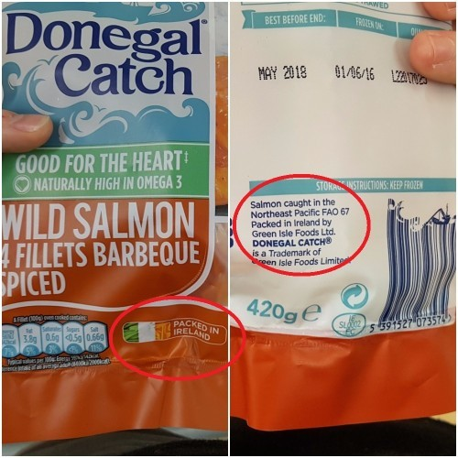

Slide 3
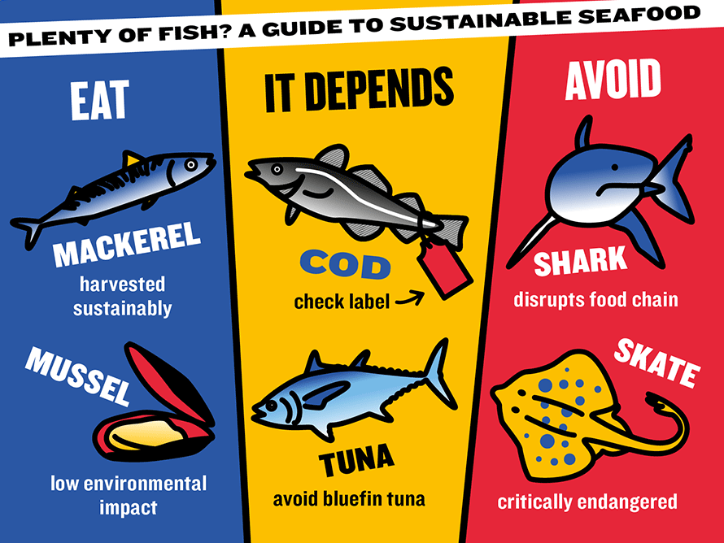
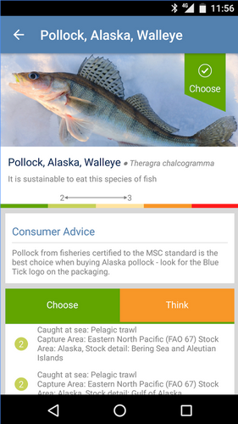
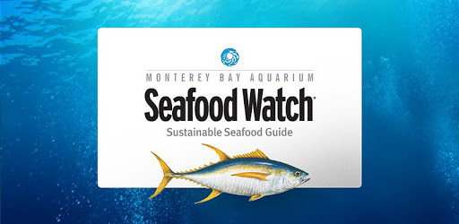
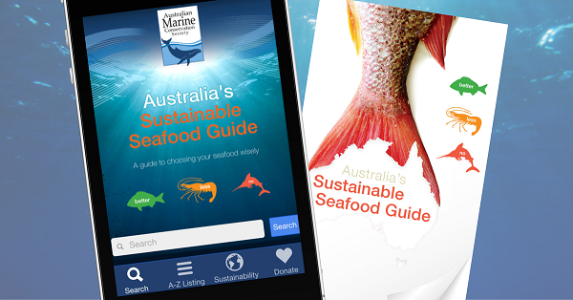
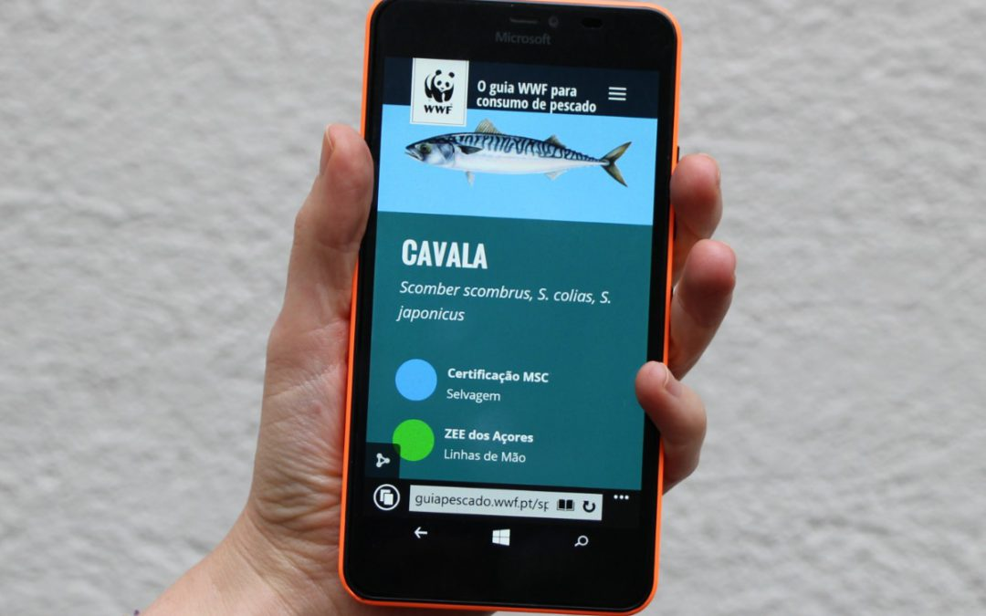
Why do we need yet another seafood app?

Slide 4
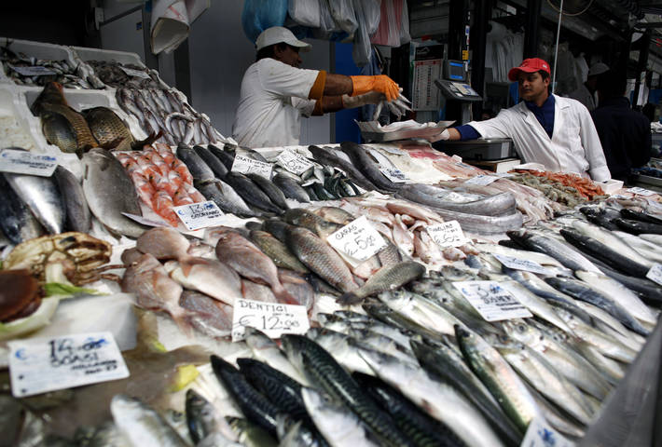
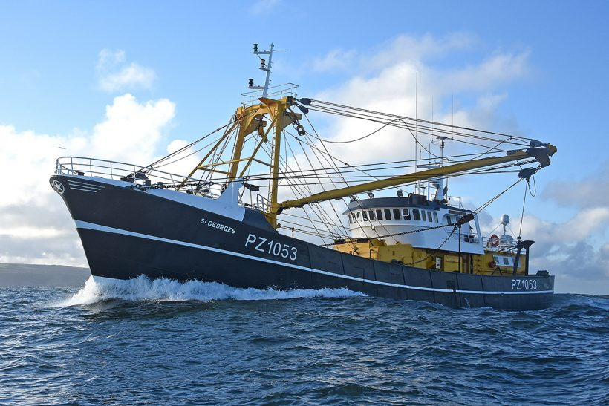
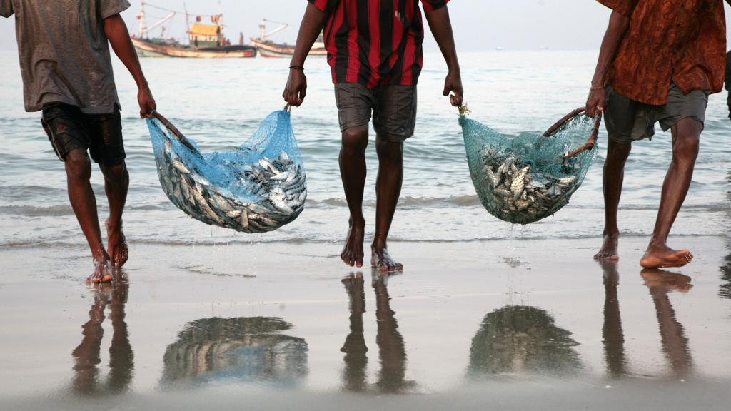
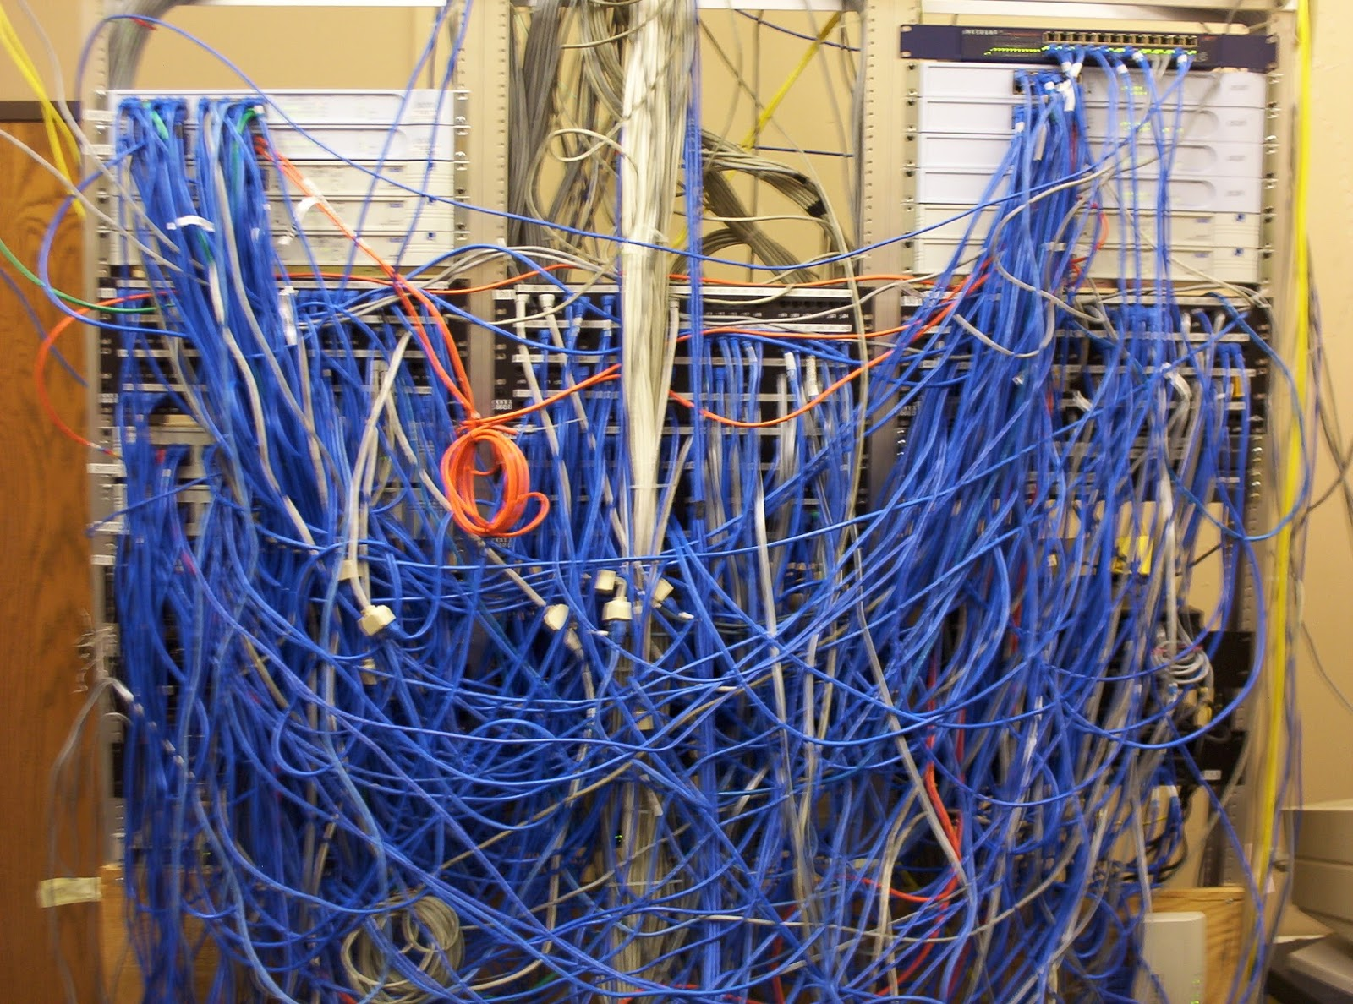
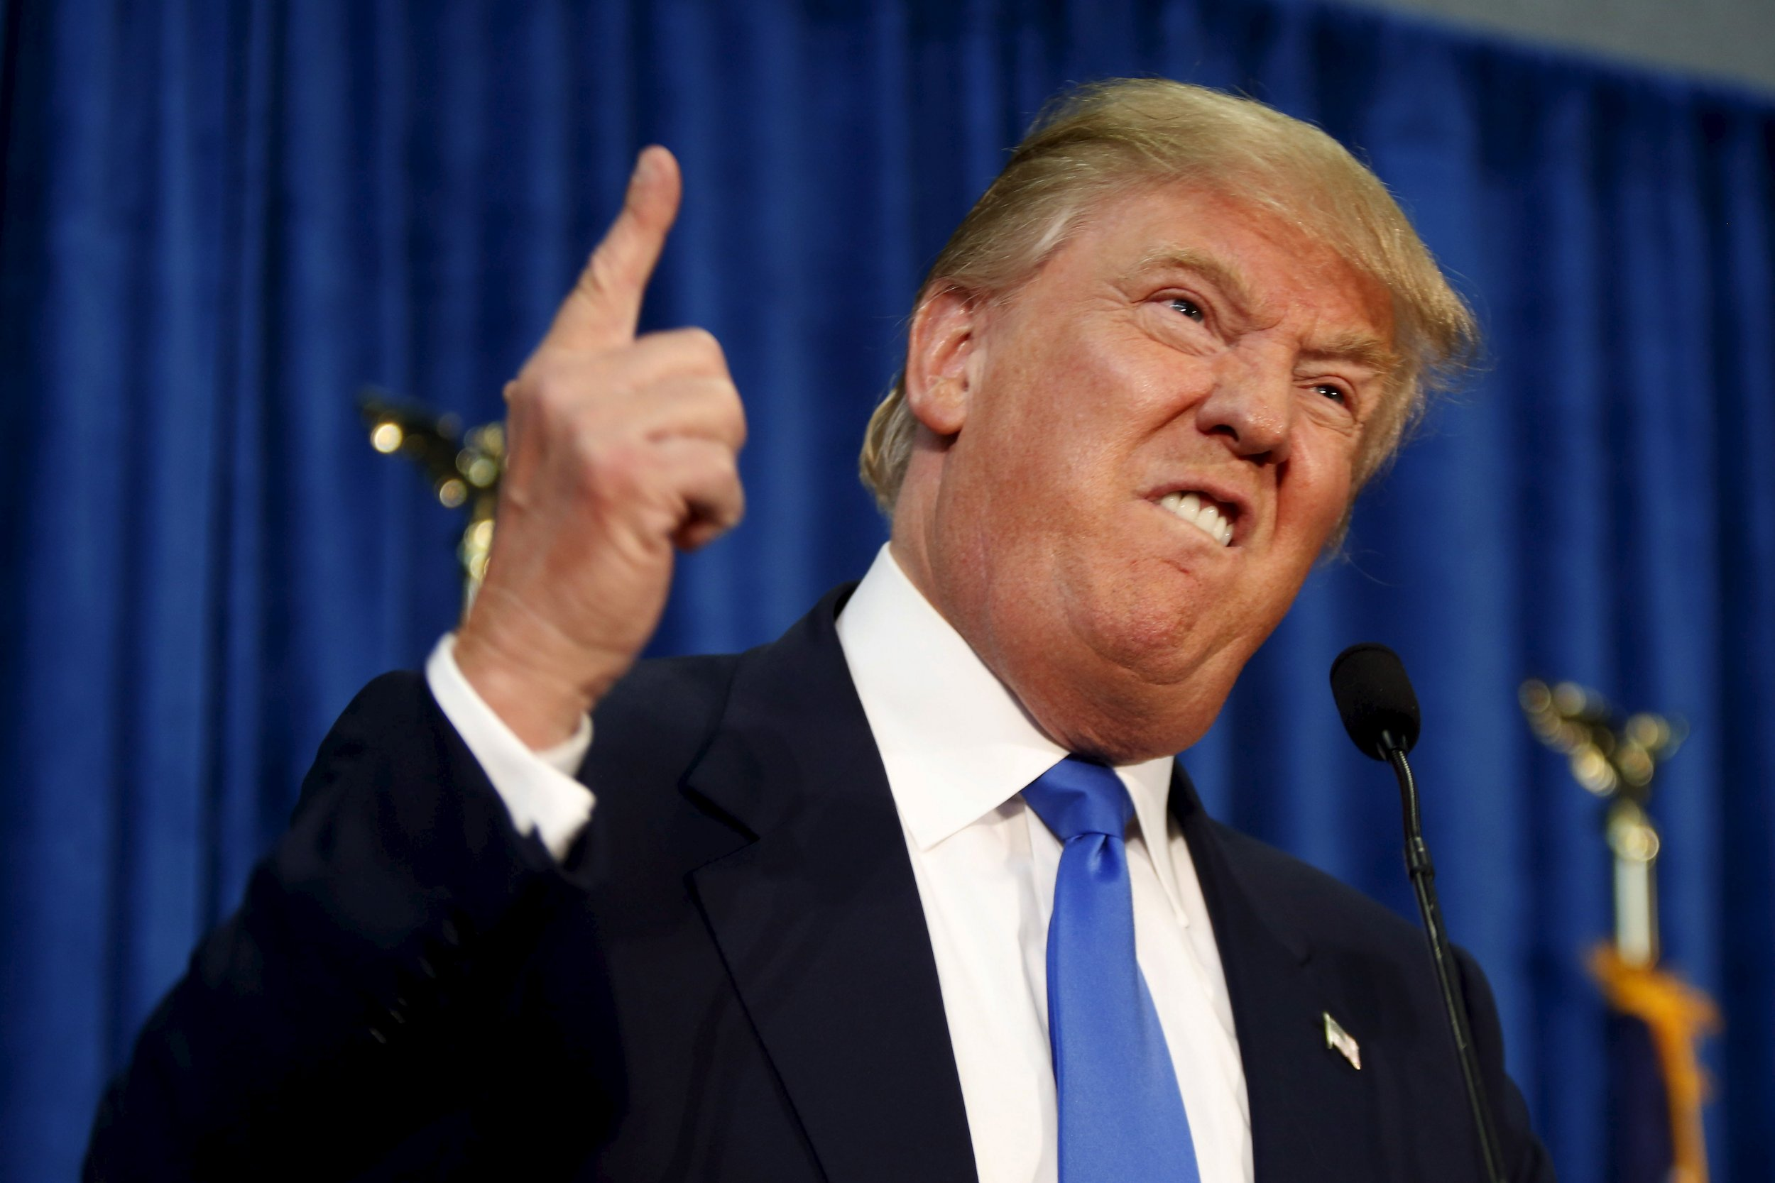
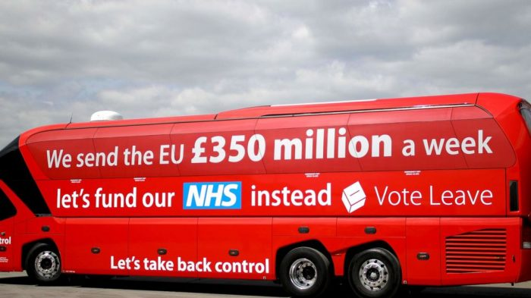
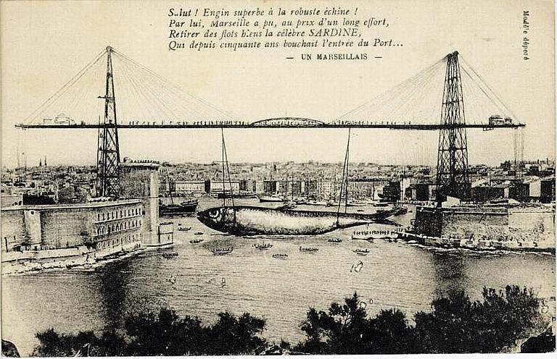
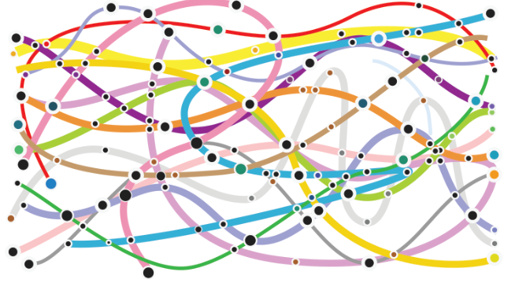
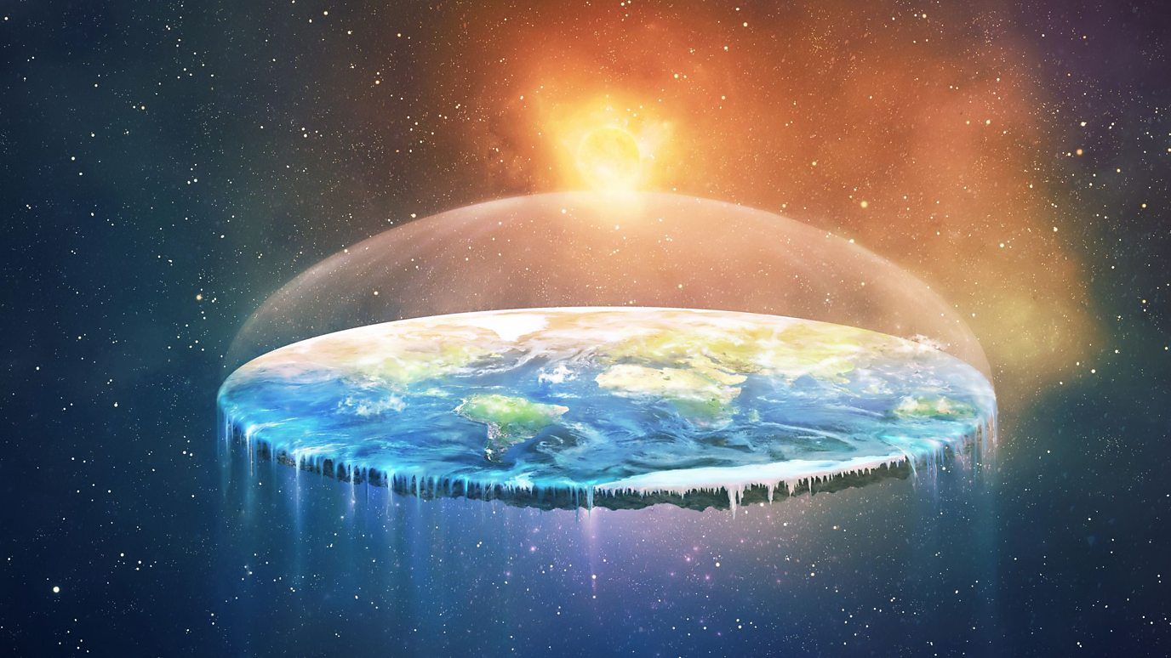
Seafood is important but fisheries data is complex and messy.
It is more important than ever to show evidence.

Slide 5

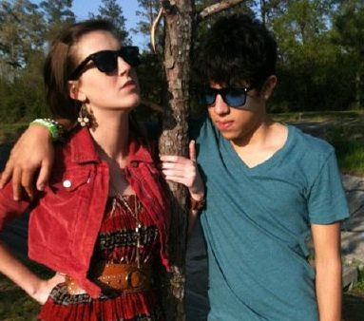
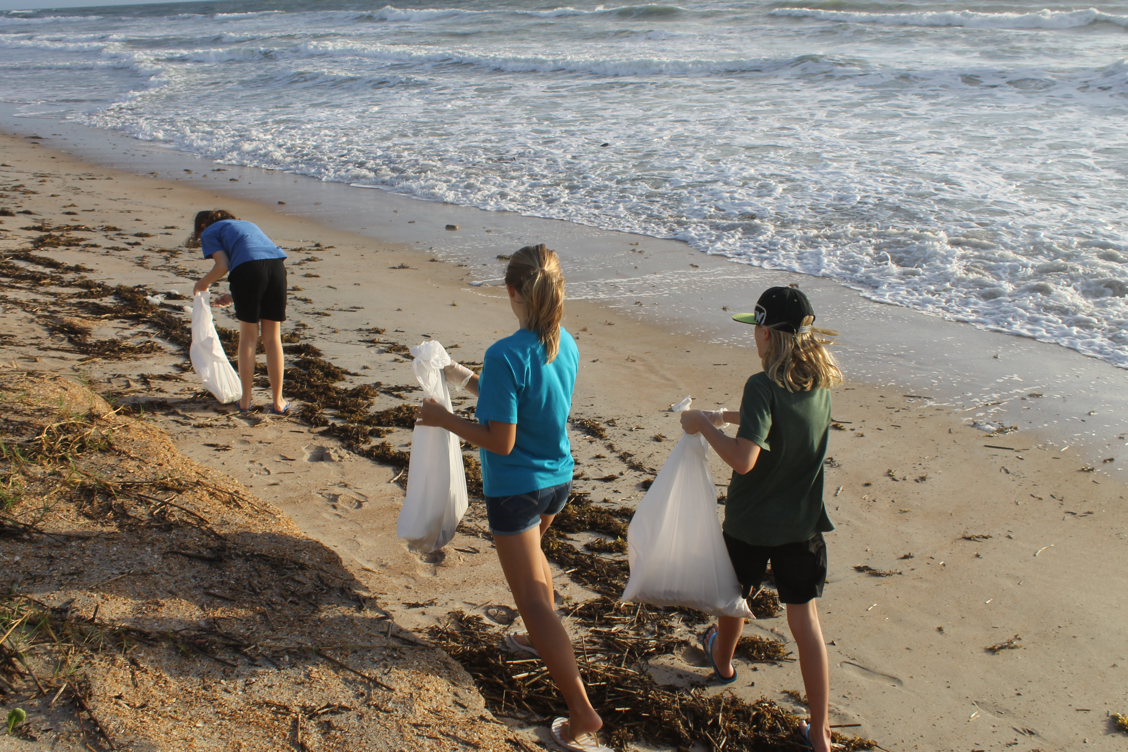
YASA target audience

Slide 6





YASA key features
Live DEMO!
the best scientific data about species and stocks in an easily accessible format
Open data & OPEn code
https://github.com/Team4-OSL-2019

Slide 7
Who we are
Technical
Laurent Dubroca
Ifremer, France
Ibrahim Umar
IMR, Norway
David Currie
Marine Institute, Ireland
Jordan Moss
IMBRsea, Ghent

Slide 8
Who we need
Technical
Social Science
Laurent Dubroca
Ifremer, France
Ibrahim Umar
IMR, Norway
?
David Currie
Marine Institute, Ireland
Jordan Moss
IMBRsea, Ghent

Slide 9
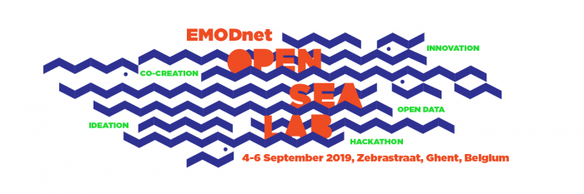
Questions?

